Slide 1
1.1
Air Conditioning
Definition, Purpose, and Scope
occupied
space
Visual lecture deck · ~30 minutes
Teaching stance: let students read the picture first, then explain the engineering.
Notes:
Timing: 1 minute. Open by telling students that today we will not define air conditioning as “making a room cold.” We will build the definition by looking at what a controlled indoor environment must do. Point to the room visual: the room is the system boundary, and the air inside has multiple properties that can be controlled.

Slide 2
Cooling alone is not air conditioning
Start with the misconception and correct it visually.
“Just make it cold?”
cold air
Temperature
Engineering definition:
Simultaneous control of air properties to meet a purpose.
Humidity
Air circulation
occupied
space
Air cleanliness
Notes:
Timing: 2 minutes. Ask: If a room is cold but humid, smelly, and stagnant, is it air-conditioned? Let students answer. Then reveal the four parameters. Emphasize “simultaneous.” A system that controls only temperature may still fail the engineering definition.

Slide 3
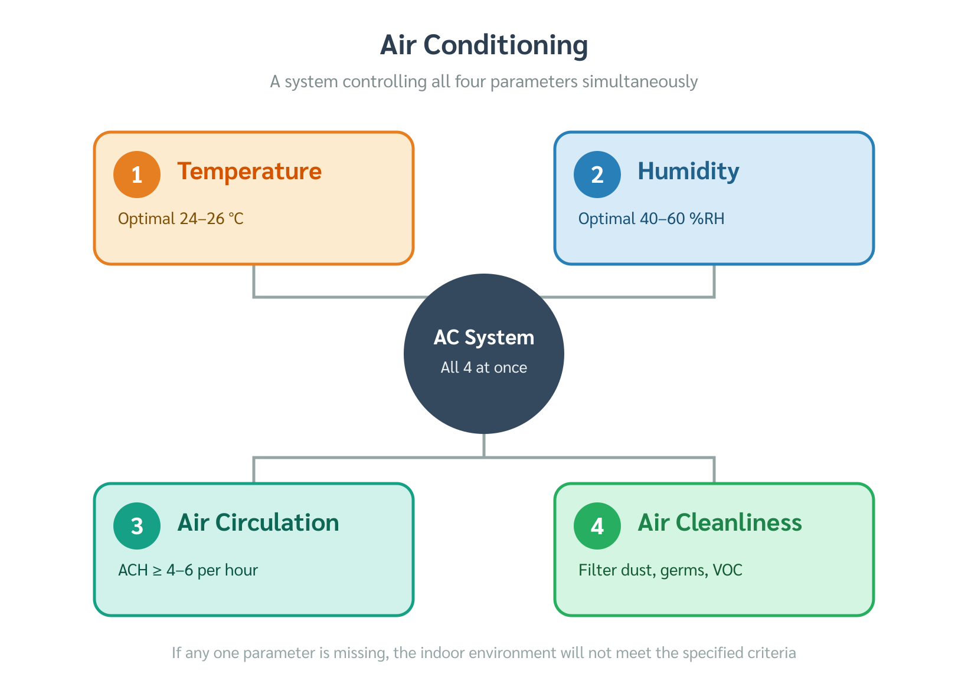
Four parameters must be controlled together
Use the 2×2 visual as the core definition.
TA_YK original figure inserted for review
Temperature
Humidity
Dry-bulb target
Moisture / %RH
SIMULTANEOUS
CONTROL
Purpose determines targets
Air circulation
Air cleanliness
Distribution + fresh air
Filtration + contaminants
Notes:
Timing: 2 minutes. Walk clockwise around the four quadrants. Do not read them as a list only; connect them. Example: lower temperature changes relative humidity; air circulation affects perceived comfort; filtration and outdoor air affect cleanliness. End with: the design target depends on purpose.

Slide 4
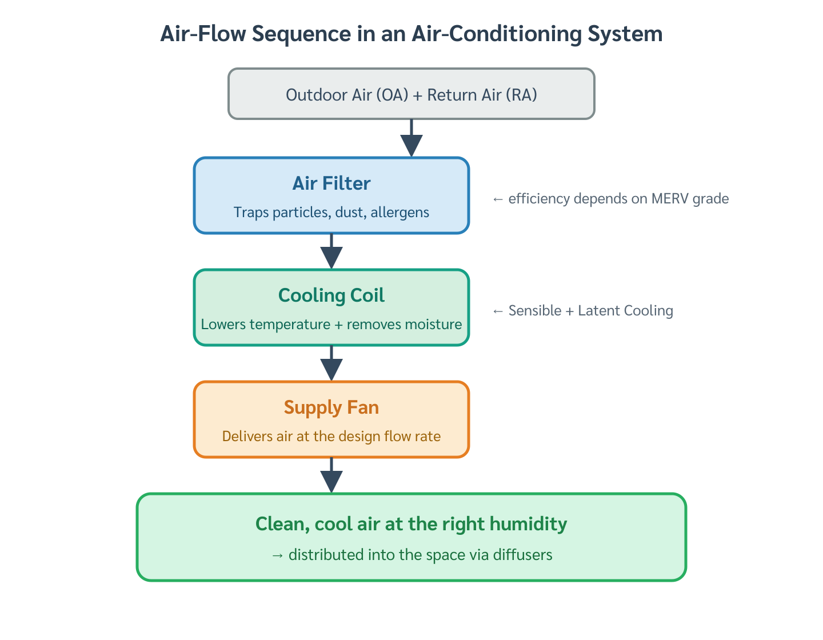
If one control fails, the whole environment can fail
A good temperature reading does not guarantee a good indoor environment.
TA_YK original figure inserted for review
Typical failure modes
1
24–26 °C
2
RH too high
Humidity high
sticky feeling, condensation, mold risk
Airflow poor
hot spots, drafts, uneven comfort
Cleanliness poor
odor, dust, bioaerosol exposure
3
stagnant air
occupied
space
4
poor filtration
Notes:
Timing: 2 minutes. Point to the room first. Tell a story: students complain even when the thermostat says 25 °C. Ask what could be wrong. Then reveal humidity, air movement, and cleanliness. This slide trains them not to diagnose comfort from temperature alone.

Slide 5
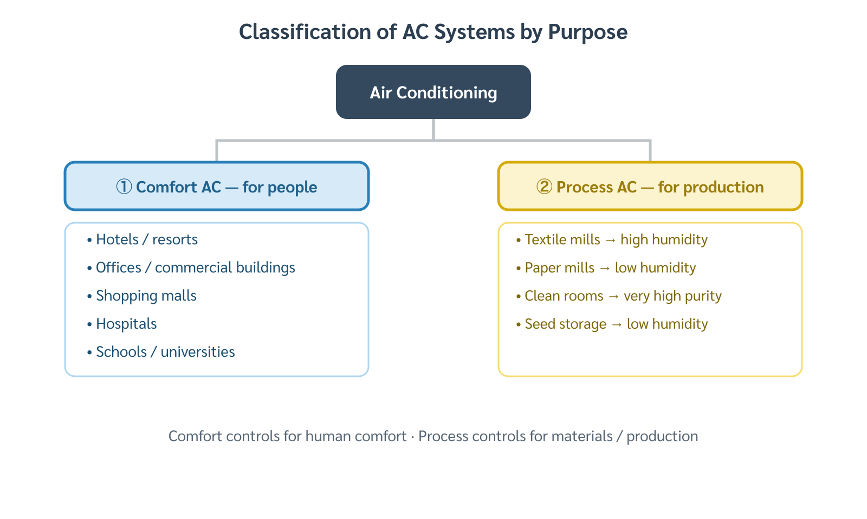
Purpose changes the design target
Comfort AC and process AC use the same variables for different goals.
TA_YK original figure inserted for review
Comfort AC
Process AC
Goal: human thermal comfort
Goal: material/process requirement
Design around the body’s heat rejection: convection, radiation, conduction, evaporation.
Targets may be uncomfortable for humans but necessary for product quality or safety.
Typical examples: classrooms, offices, homes, theaters
Examples: textile, paper, seed storage, laboratories
Notes:
Timing: 2 minutes. Contrast people-centered design with product-centered design. Ask: In a textile mill, should we optimize for workers or threads? In a hospital operating room, comfort may matter, but infection control and procedure requirements dominate.

Slide 6
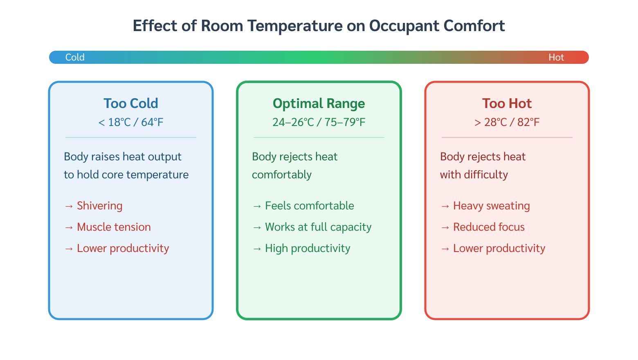
Comfort AC supports the body’s heat balance
Use the human body as the “sensor” for comfort air conditioning.
TA_YK original figure inserted for review
Comfort zone logic
2
Radiation
1
Convection
The system does not “make people cold.” It creates indoor air that allows steady, moderate heat rejection from the body.
Reference design: often around 24–26 °C in Thailand, with humidity controlled for comfort.
3
4
Evaporation
Conduction
Notes:
Timing: 2 minutes. Use the body diagram. Explain metabolism generates heat continuously. Comfort means the body loses heat neither too slowly nor too quickly. This justifies why temperature, humidity, air velocity, and surrounding surfaces all matter.

Slide 7
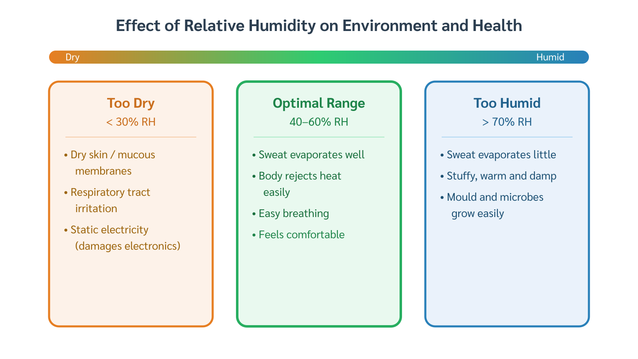
Process AC may target conditions humans would not choose
Let the product/process define the control objective.
TA_YK original figure inserted for review
Textile mill
Paper storage
Seed storage
High RH
Low RH
Low T + low RH
Keep fibers flexible
reduce static
Prevent warping
and dimensional change
Prevent germination
and mold
Notes:
Timing: 2.5 minutes. Tell three mini-stories. Textile: low RH breaks threads and causes static, so humidification can be the main AC function. Paper: humidity damages dimensional stability, so dehumidification is central. Seed storage: temperature and humidity protect biological viability. Ask students: which one is comfort AC? None.

Slide 8
Equipment sizing is a peak-load problem
Capacity must match the maximum heat gain rate during operation.
load
1
Too small
peak load
Cannot hold design conditions on worst hours.
Too large
Short-cycling, poor dehumidification, higher cost.
time
Notes:
Timing: 2 minutes. Draw attention to the curve. Explain that equipment capacity must cover the peak, but most of the time the building operates below peak. Undersizing and oversizing both create problems. This introduces why load calculation is central to HVAC design.

Slide 9
Office peak load often occurs after solar noon
Stored heat and internal gains shift the maximum into mid-afternoon.
peak design hour
envelope storage
solar radiation
people + lights + equipment
08:00
12:00
15:00–16:00
18:00
Office story: the building remembers the sun.
Notes:
Timing: 2 minutes. Tell students that solar radiation may peak near noon, but cooling load can peak later because walls, roofs, and floors store heat. Add internal gains from occupants, lighting, and equipment. For an office, the design hour often becomes about 3–4 PM.

Slide 10
Nightclub peak load is driven by people and lighting
A building with little solar gain can peak at night.
21:00–22:00
occupants + lighting + latent heat
sensible heat
latent heat
lighting
Notes:
Timing: 2 minutes. Use the dark room as a contrast to the office. Solar heat is not the dominant term. The peak arrives when the crowd is largest and the lighting is fully on. Emphasize latent load from breathing and perspiration. This prepares students to think from use-case rather than rules of thumb.

Slide 11
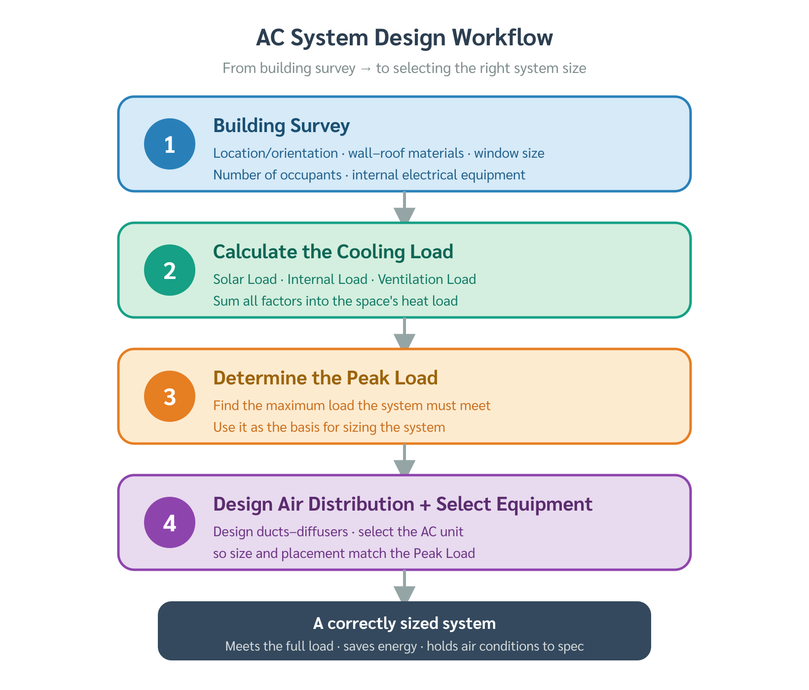
A building survey turns assumptions into inputs
The survey is the first engineering step before load calculation.
TA_YK original figure inserted for review
Survey
Load calculation
Equipment selection
Operation
measure + collect
convert data to heat gain
capacity + system type
comfort + reliability
Bad survey → bad load calculation → wrong equipment → comfort and energy problems
Notes:
Timing: 2 minutes. Make the workflow feel like a chain. If the first link is weak, everything after it is compromised. Explain that survey data includes geometry, orientation, use schedule, people, lights, equipment, and climate.

Slide 12
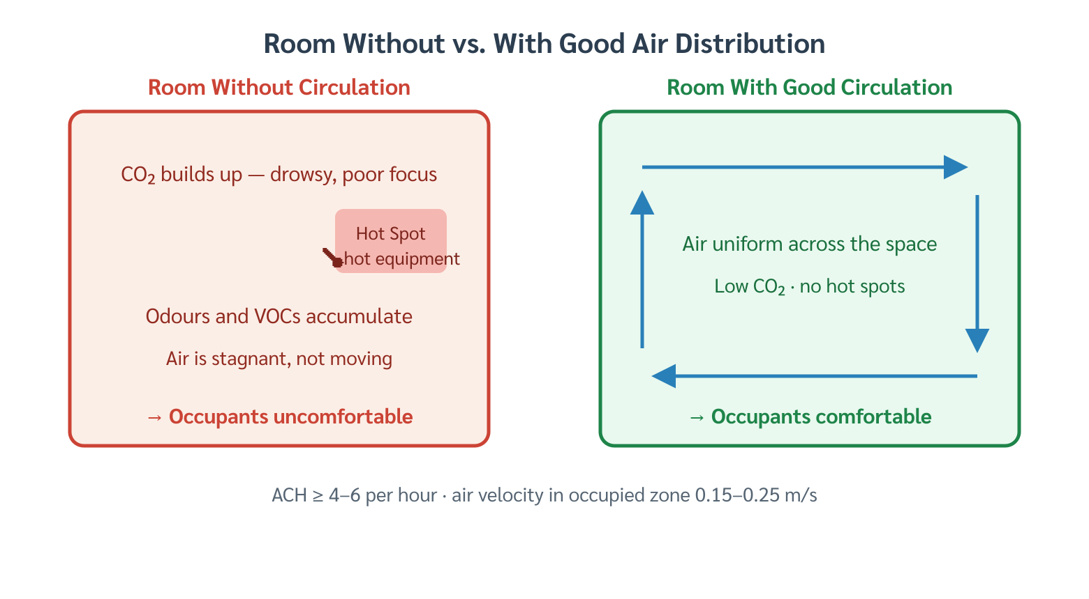
What must be surveyed?
Organize inputs into external and internal data.
TA_YK original figure inserted for review
External data
Internal data
1
location + latitude
1
area + volume
2
orientation
2
occupants + activity
3
shading / surroundings
3
lighting density
4
walls, roof, glazing
4
equipment + schedule
Survey data are not paperwork — they are boundary conditions for engineering calculation.
Notes:
Timing: 2 minutes. Treat this as an image of two buckets. External data describes how the outside world attacks the building. Internal data describes heat generated inside the space. Connect the terms to later chapters: Chapter 3 survey, Chapter 4 onward load calculation.

Slide 13
This course focuses on cooling-mode AC in Thailand
Scope the textbook/course so students know what is included and excluded.
Thailand context
High outdoor temperature
+ high humidity
+ cooling demand dominates
Main action:
remove heat + moisture
Heating systems for cold climates are outside this course scope.
Notes:
Timing: 1.5 minutes. Explain the course boundary. Air conditioning in the broad engineering definition includes heating, cooling, humidification, and dehumidification. But in this course and in the Thailand context, the dominant design problem is cooling and moisture removal.

Slide 14
Pause question: which parameter controls the problem?
Use this as an interactive slide before summarizing.
A classroom is 25 °C but students feel sticky.
Humidity / air motion
Threads break in a textile weaving hall.
Humidity
A server room runs hot after installation.
Cooling load / equipment capacity
A room smells stale despite correct temperature.
Fresh air / cleanliness
Notes:
Timing: 3 minutes. Hide the answers if presenting live by duplicating the slide or covering the right column. Ask students to diagnose each case. Then reveal the right column. The key is to make them think in terms of controlled variables and purpose, not equipment names.

Slide 15
Topic 1.1 — what students should remember
1
AC = simultaneous control
temperature + humidity + circulation + cleanliness
2
Purpose sets the target
comfort AC ≠ process AC
3
Capacity follows peak load
office and nightclub can peak at different hours
4
Survey comes before calculation
survey data become load-calculation inputs
5
Thailand scope
cooling and dehumidification dominate
Next: system types and components
Notes:
Timing: 2 minutes. Summarize without reading every word. Ask students to say the four parameters. Then ask: what comes first in design? Purpose, then survey, then load calculation, then equipment selection. Close by linking to the next topic.

